Slide 1
Reproducible Research using R Markdown
Ramaa Nathan

Slide 2

About me
I am a fellow data enthusiast
Worked in different roles in the financial and healthcare industry
Newly minted statistician
Looking for a new position as a statistician or data scientist
Free time - Run and Teach healthy Indian Vegetarian cooking
Co-organize Data Philly Meetup events
Notes:
worked in different roles as a quant developer, data analyst, quantitative researcher, project manager. Got very interested in doing core data science and so decided to study statistics.

Slide 3
Outline
Reproducible Research
Concepts
Literate Programming
R Markdown
Case Study: Survival Analysis
Generating Different Types of Documents using R Markdown

Slide 4
Reproducible Research
Important for research and scientific claims to be reproduced and validated by independent investigators
Importance for reproducibility highlighted by the scandal in 2006
Cancer research scientists at Duke University falsified data
Research could not be reproduced by scientists at MD Anderson
Reproducible Research Standards proposed by Victoria Stodden in 2009
Notes:
For several centuries, scientists and researchers have been making great scientific innovations. Whenever possible, these findings have been tested and validated by others. It was relatively easy earlier. But is becoming harder withe the advances in technologies, methodologies, and big data. Victoria Stodden from Standford University Details on types of reproducible research on the R OpenScience website

Slide 5
Reproducible Research
Replication: Independent people going out and collecting new data
Reproducibility: Independent people analysing the same data
Reproducible Research
Make analytic data and code available so that others may reproduce the findings.
Notes:
Not all research can be reproduced in its entirety - research may be too involved, require a lot of time and funding
Roger Peng of Johns Hopkins Distinguishes between replication and reproducibility
Reproduce research for validation or for learning
In general, rr corresponds to reproducing and validating the Data Analysis component.

Slide 6
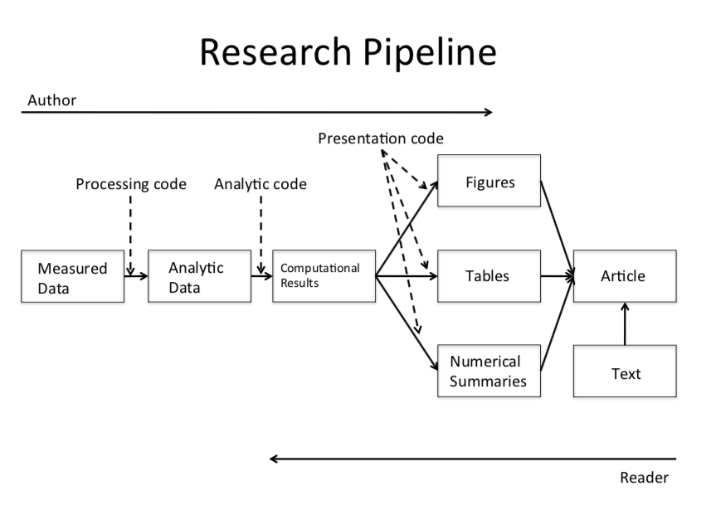
Research Pipeline
From Roger Peng’s Reproducible Research Course

Slide 7
Reproducible Research - What is needed?
Data (Raw / Processed) with Data Dictionary
Documented Source Code
Software Environment
Notes:
To make their research or work reproducible, scientists or authors in general will need to make information on all these publicly available.
For reproducible research, it is best to use open souce software and platforms or release information under a Creative Commmon Attribution (CC-BY) License

Slide 8
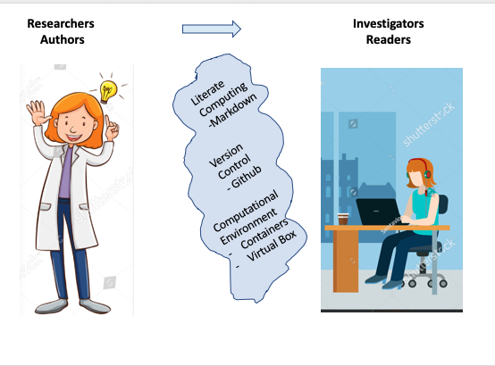
Reproducible Research - Tools Required
Notes:
Sharing Research is not as easy as it sounds. - Authors want to make their research reproducible - Readers want to reproduce the research
Challenges: - Authors must take care to explain their analysis in a comprehensive manner such that all information is in one location. Literate Programming like Markdown documents helps with this - Authors must be able to provide the data in an easily accessible manner. Version Control public repositories like Github help with this - The readers need to have a similar computational environment to be able to reproduce the results. With the available exhaustive technology, each computational environment in research institutions or corporations vary vastly. So the resources may not match. In addition, a complete research project may have several dependencies in addition to the data and code. Containers like docker or Amazon ECSmake it very easy to package and deploy the entire software.

Slide 9
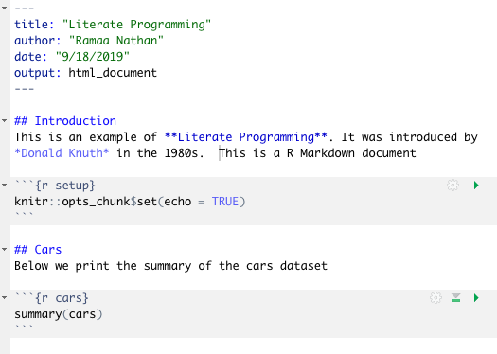
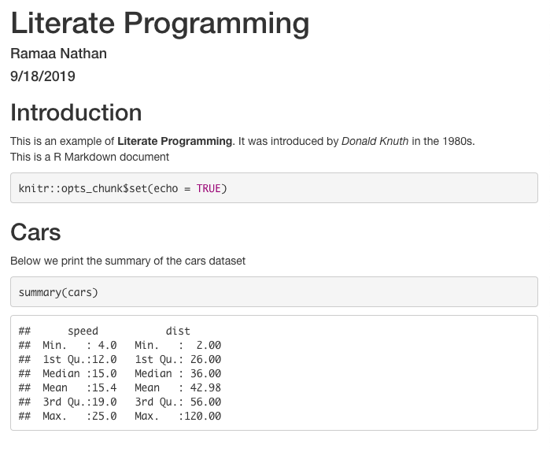
Literate Programming
Literate Program with Document sections and Programming sections interweaved
Literate Program Output
Notes:
Programming paradigm introduced by Donald Knuth in the 1980s. Combines programming language with a document language
Natural language like English is interspersed with snippets of source code. Article text explains what is going on without the need to read
In general, Markdown is used as the Document Language which is basically a text to HTML converter and is a simplified version of a “markup” language"
Markdown helps to easily create HTML header or section, itemized and ordered lists, bold and italics formats, and provide links to external links and image
Examples are
R Markdown which uses Markdown as the document language and R as the programming Language
Jupyter with Python which uses Markdown as the document language and Python as the programming Language

Slide 10

R Markdown Technology Stack
render function in rmarkdown package encapsulates this complete process

Slide 11
Outline
Reproducible Research
Concepts
Literate Programming
R Markdown
Case Study: Survival Analysis
Generating Different Types of Documents using R Markdown

Slide 12
What is Survival Analysis?
Branch of statistics used for analyzing the expected duration of time until one or more events occur
Events - Death in biological systems - Relapse of cancer - Failure in mechanical systems - Loan performance in economic systems - Time to retirement - Time to finding a job
Notes:
The concept of an event is different in different areas of study. I have chosen to do survival analysis of breast cancer where the event of interest could be relapse of cancer, death, etc.

Slide 13
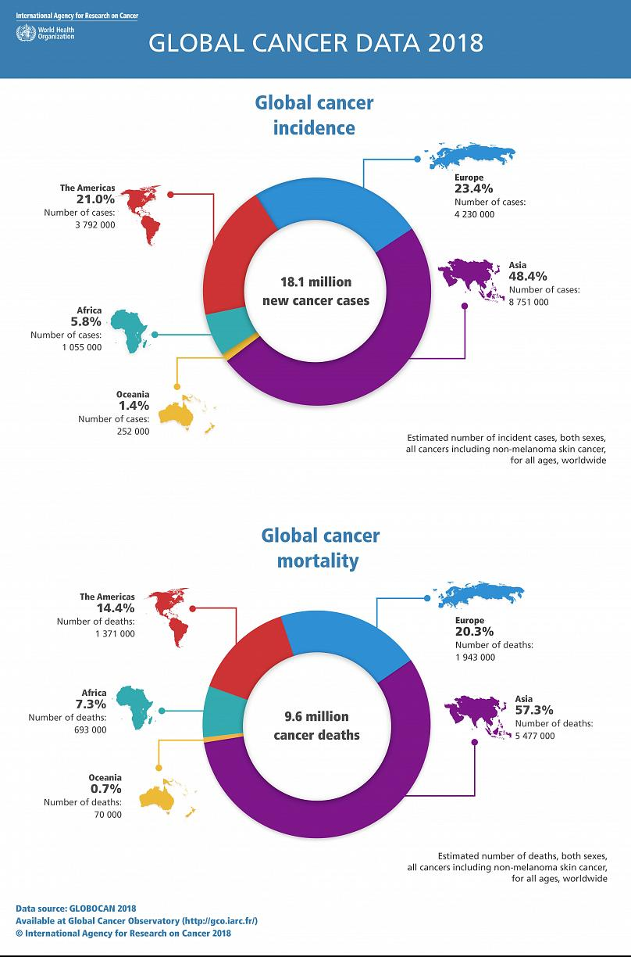
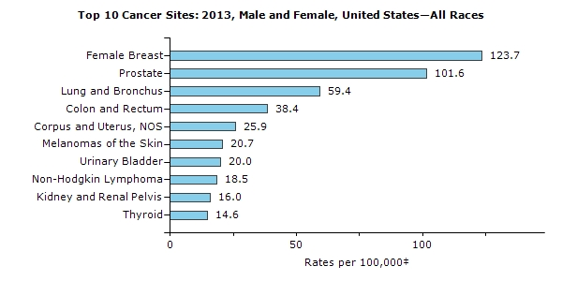
Cancer Statistics
Notes:
Cancer is among the leading causes of death worldwide
as per the Cancer Statistics from the National Cancel Institute.
Death due to cancer is over 50% worldwide and around 35% in the united states and so is a major concern.
On a personal note, right around the time that I was researching for a topic to work on, one of my best friends was diagnosed with breast cancer. So, I decided to study the survival analysis of breast cancer.

Slide 14
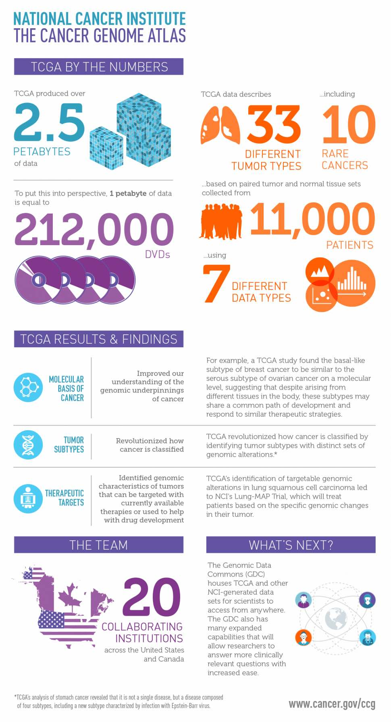

Where do we get the data from?
Notes:
The Cancer Genome Atlas (TCGA) Program is a joint effort between the National Cancer Institute and the Human Genome Research Institute
Provides publicly-available clinical and high-throughput genomic data for thirty-three different types of cancers.
Data source is widely used by researchers and has led to vast improvements in diagnosing, treating, and preventing cancer.

Slide 15
Survival Analysis - Terminologies
Variable of interest: Time to Event
Examples include survival time from onset of diagnosis, time until progression from one stage of disease to another, and time from surgery until hospital discharge.
Statistical Measures of Interest:
Survival Function: Probability of surviving beyond time t
Hazard Rate (Risk of Death): Probability that if a person survives to time t, they will experience the event in the next instant.
Cumulative hazard: Accumulation of hazard rate over time since time of first diagnosis
Hazard Ratio: Ratio of two hazard functions and is used to compare the risk of death between two treatment groups

Slide 16
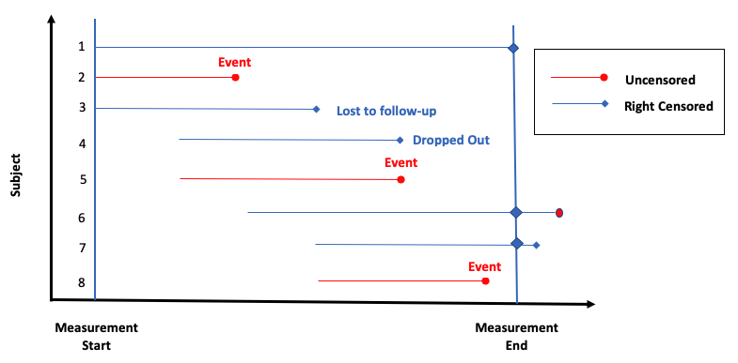
What is Censoring?
An event is censored if there is some amount of follow-up on a subject and the event is not observed during the study period
Notes:
Central to survival analysis is the concept of censoring
In any clinical study where the variable of interest is time to events all subjects may not experience the event during the period of study. In such cases, the time to event is considered to be censored.
There are three types of censoring - left, right, and interval. We consider only right censoring here
Right Censoring: Event is not observed because of loss-to-follow-up, death from a cause other than the trial endpoint, study termination, and other reasons unrelated to the endpoint of interest.

Slide 17
Research Questions
What is the median survival time for breast cancer?
What are the important factors that influence risk of death for Breast Cancer?
What are the effects of each factor on survival of breast cancer?
How do all factors together influence the survival time of breast cancer?

Slide 18
TCGA - Important Variables
ColumnName | DataType | Description
Gender | categorical | Gender
Race | categorical | Race
Ethnicity | categorical | Ethnicity
Age | integer | Age at first diagnosis
Vital Status | binary | Vital Status (1 - dead (event), 0 - alive/censored)
Days to Death | integer | Number of days to death from first diagnosis
Days to Followup | integer | Number of days to last follow-up from first diagnosis
Notes:
The TCGA dataset contains 3703 variables from which a few variables containing demographic and cancer stage information are selected as important predictors or independent variables for survival analysis.

Slide 19
TCGA - Important Variables
ColumnName | DataType | Description
Therapy type | categorical | Therapy Type (Chemo, Harmone, Immuno, etc.
Pathologic Stage | categorical | Cancer stage - based on T,M, and N labeling
Pathology T | categorical | Tumor (T) stage describing size and location of tumor
Pathology N | categorical | Lymph (N) nodes status describing if cancer has spread into nearby lymph nodes
Pathology M | categorical | Metastasis (M) status describing if cancer has spread to other parts of the body
Notes:
Data transformations are applied to the raw data 1. Rename the long variable names to short names. 2. Filter out the 12 observations corresponding to males diagnosed with breast cancer. 3. Filter out the 2 observations with negative “times” value. 4. Create a “age” variable that contains the number of days at first diagnosis to age in years at first diagnosis. 5. Create a “years_to_event” variable which is the “times”" variable converted from days to years. 6. Data in the pathology columns contain information on both stage and sub-stage. Transform the data to only contain the high level stage information. 5. Modify the “therapy_type”" to contain three types - chemotherapy, hormone therapy and Other (lump all the other infrequent types into Other) 6. Modify the “race”" to contain three types - black or african american and white (lump the other two types into Other)

Slide 20
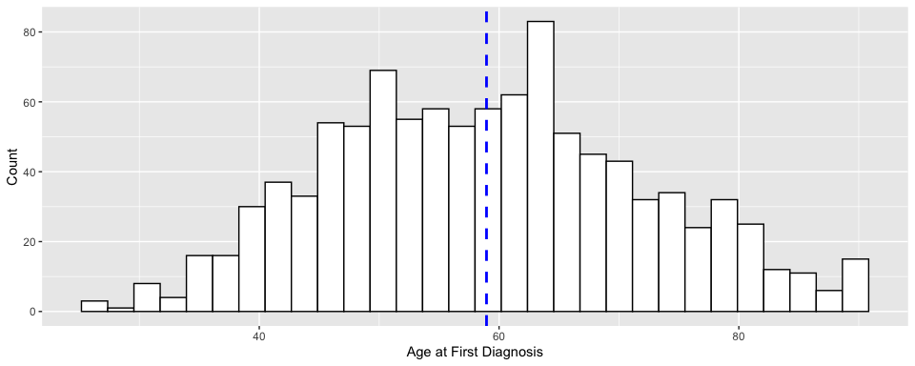
BRCA - Age at First Diagnosis

Slide 21
Notes:
We have a total of 1032 observations. The distribution of age at first diagnosis is mostly symmetric with an average of 59 years, a standard deviation of 13 years and ranging from 29 years to 90 years.

Slide 22
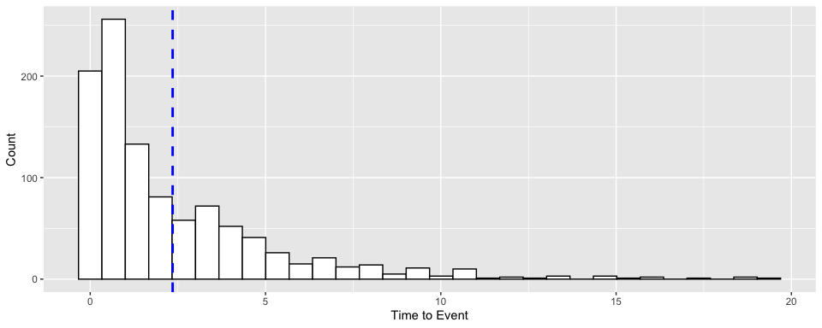
BRCA - Time to Event

Slide 23
Notes:
Distribution of years to the event (either censored or death) and without considering censoring is right skewed with an average value of 2.5 years and a standard deviation of 2.8 years. This is not helpful information as censoring information is an important component of survival data. So, we will only consider right censored plots to observe the data.

Slide 24
Survival Function Modeling
Non Parametric Model - Kaplan Meier
Probability of Survival at Time x and Median Survival Time
Comparison of survival curves for different groups using log-rank or MH statistic
Parametric Models - Exponential and Weibull
Compare Survival Time and Risk of Death between different groups
Semi Parametric Model - Cox Proportional Hazard Model
Determine significant covariates
Compare survival time and risk of death between different groups
Notes:
To answer our research questions, we need to model the data.
We will analyze each factor or predictor separately and study its effect on survival time. We will then consider all the predictors together
For each predictor, we will apply the three types of models – non-parametric, parametric and semi-parametric, Together, they provide all the information required for survival analysis.
In a non-parametric method like Kaplan Meier survival curve, the survival data is not assumed to follow any specific distribution. Only empirical information from the data is used for modeling
In the parametric models, the survival data is assumed to follow a specific distribution – like exponential, Weibull, log-logistic, etc. I have only considered the Exponential and Weibull distributions here
The Cox Proportional Hazard Regression model is semi-parametric, containing both parametric and non-parametric components. This model also makes no assumptions on the distribution of the survival data and is used to model the hazard or instantaneous risk at time t in the presence of covariates. The hazard rate is modeled as a linear combination of the covariates like age, race, therapy type, and cancer stages.

Slide 25
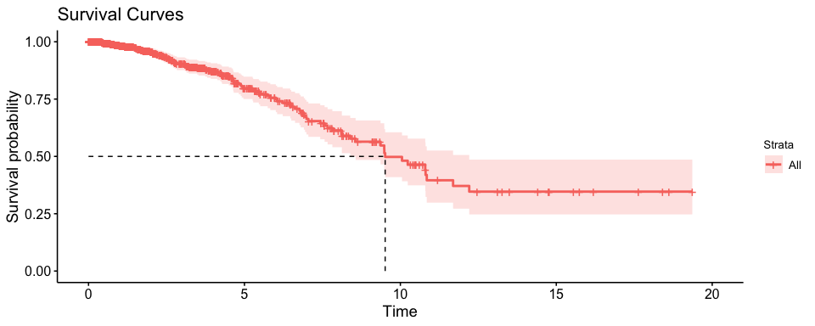
Overall Survival of BRCA: Kaplan Meier

Slide 26
Notes:
The Kaplan-Meier survival curve shows the change in probability of survival since time of first diagnosis for a person diagnosed with breast cancer and when none of the predictors are accounted for. It can be seen that the survival time for a person decreases very slowly for the first five years, then decreases almost linearly from five to ten years and stabilizes around 12 years. There were a total of 104 events out of the 1032 observations. The overall point estimate of the median survival time is 9.5 years.

Slide 27
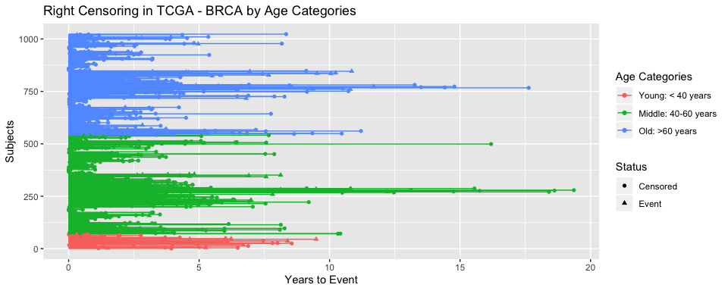
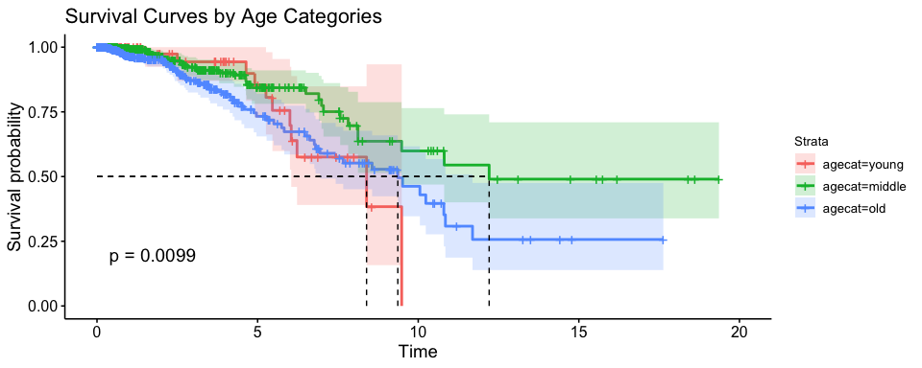
Age
Censoring & Event Plot
Kaplan Meier Survival Curve
Notes:
The age at first diagnosis is split into 3 groups: young, old and middle
Less than 10% of the subjects are less than 40 years old. The number of subjects in the other two groups are almost equally distributed.
The survival rate is higher in the young group (92%) than in the old group ( 88%).
The median survival time is the highest for the middle age group at 12.21 years and at 9.36 years for the old age group followed by 8.4 years for the young age group.
On comparison of the curves using log-rank statistic, the middle and old age groups are found to be significantly different.
So Age is a significant predictor

Slide 28
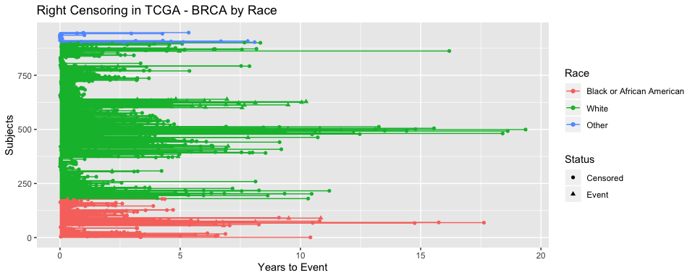
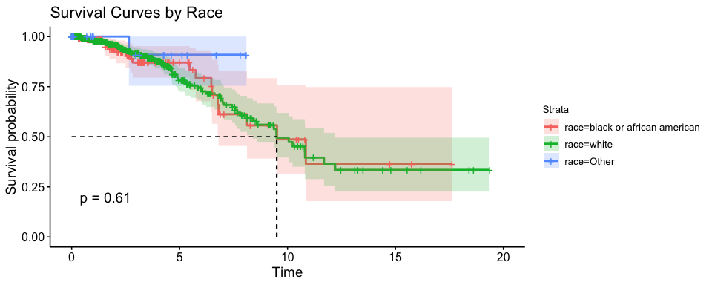
Race
Censoring & Event Plot
Kaplan Meier Survival Curve
Notes:
The race information is missing for 10% of the subjects. 76% of the subjects are white, 18% are black and only 6% are of other races. The survival rate is approximately 90% for subjects of both the black and white races.
The survival curves for both the races - white and black or African-American are very similar with a median survival time of 9.5 years. The log rank test also indicates that the survival curves are not significantly different. So, race is not a strong predictor of survival rate.

Slide 29
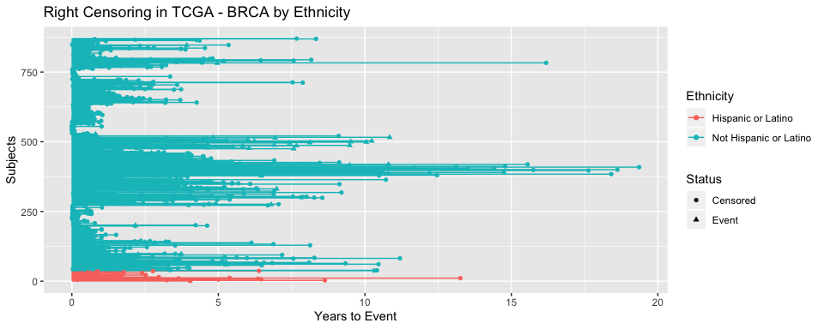
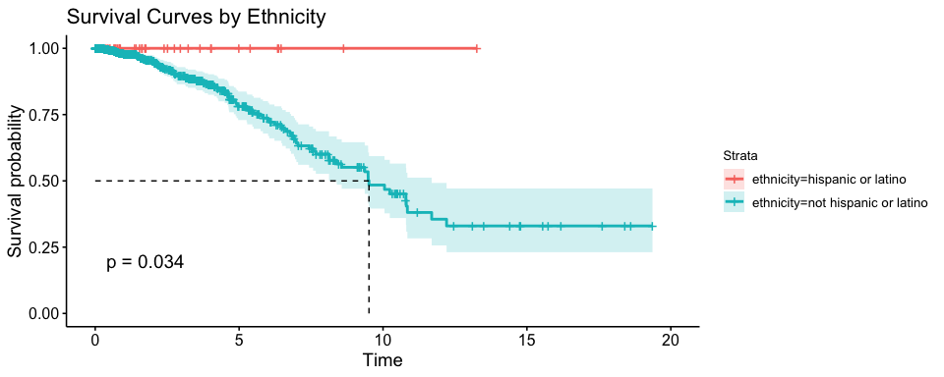
Ethnicity
Censoring & Event Plot
Kaplan Meier Survival Curves
Notes:
the number of Hispanic or Latino patients is very small with 96% of the subjects being non-Hispanic or Latino.

Slide 30
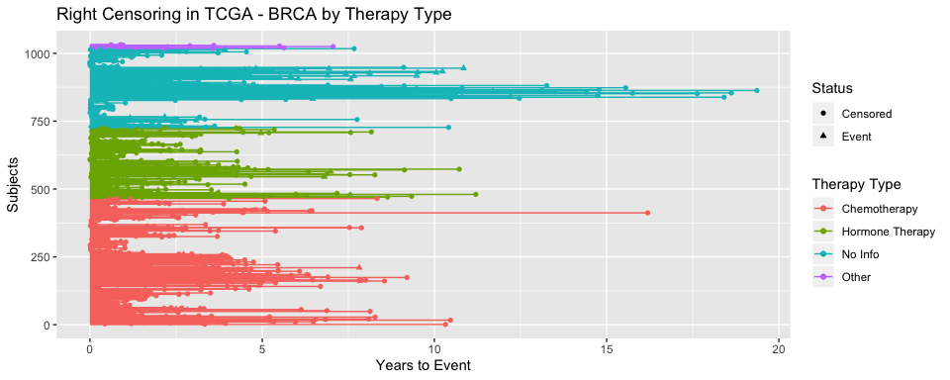
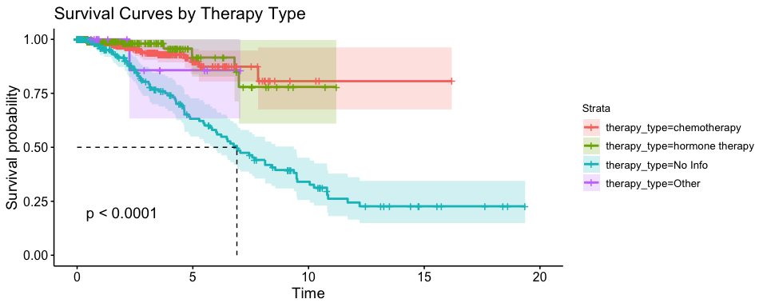
Therapy Type
Censoring & Event Plot
Kaplan Meier Survival Curves
Notes:
45% of the subjects are on chemotherapy, 25% are on hormone therapy, 1% on other therapy. There is no information on therapy for 25% of the subjects. The group with no information on therapy has the highest event rate at 26%.
we observe that there is a big difference in survival and hazard rates between the groups of subjects administered some form of treatment and the group with no treatment reported.
The risk of death for subjects on no treatment is five times higher than subjects administered some form of treatment with the median survival time being less than 7 years
Therapy Type is a significant predictor

Slide 31
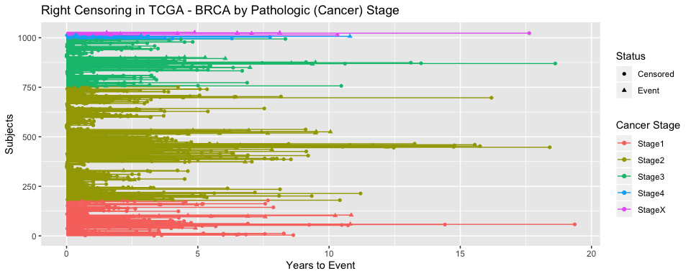
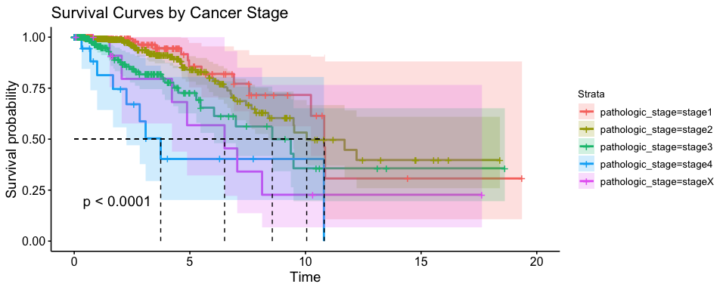
Pathological Cancer Stage
Censoring & Event Plots
Kaplan Meier Survival Curves
Notes:
Approximately 50% of the subjects are diagnosed with stage 2 cancer, while less than 2% of the subjects are either in stage 4 or in stage X. The percentage of events is the highest (almost 50%) for the stage 4 and stage X groups and the lowest (7%) for stage 1
we observe that the hazard rate steadily increases with increase in the diagnosed cancer stage number. Correspondingly, the median survival time steadily reduces from 10.8 years for stage 1 to 3.7 years for stage 4.
Next when we compare the survival curves in pairs, we find that only survival curves for stage1 and stage2 are not significantly different
The survival curves are found to be significantly different
When compared with stage 1 group, the survival time reduces By 16% for stage 2, By 45% for stage 3 By 70% for stage 4
Pathological Cancer stage is a significant predictor

Slide 32
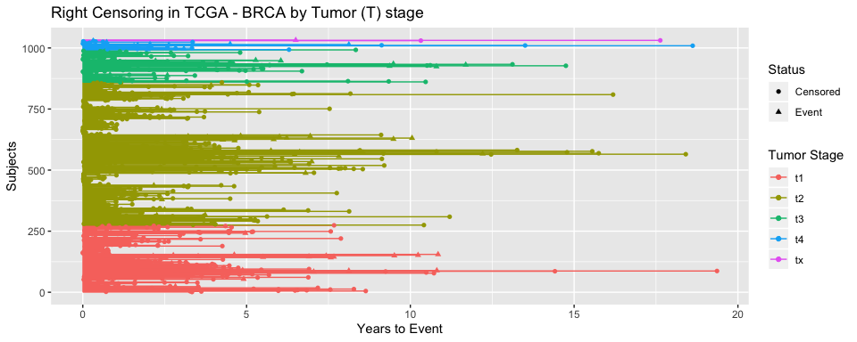
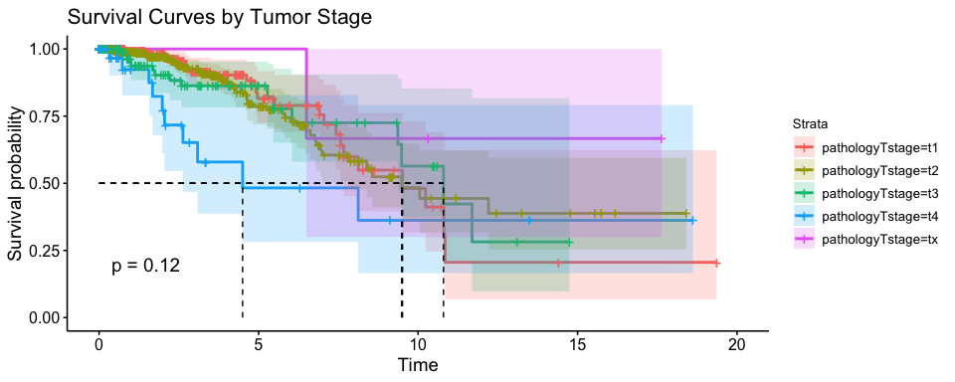
Tumor (T) Stage:
Censoring & Event Plots
Kaplan Meier Survival Curves
Notes:
50% of the subjects have stage 2 tumors, followed by 25% of the subjects with tumors in stage 1. The survival rate decreases with the stage of the tumor from 95% for stage 1 to 73% in stage 4.
The median survival time is an average of 10 years for the first three tumor stages and reduces to 4.5 years for the t4 stage. When we compare the survival curves for the different tumor stages, we find that the curves are not statistically significantly different. This implies that that the tumor stage is not a strong predictor of survival rate.

Slide 33
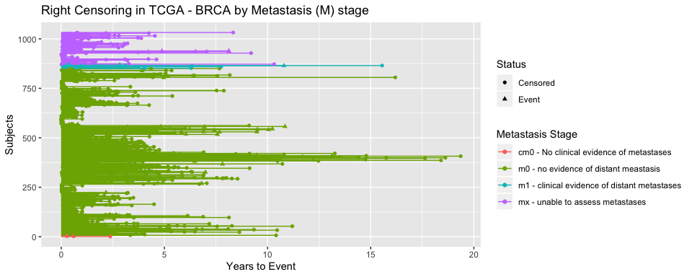
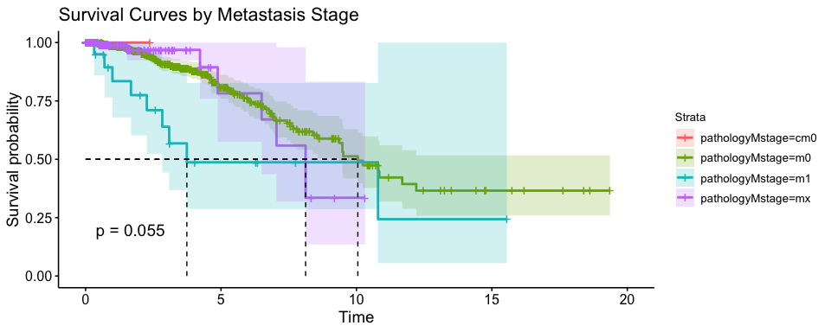
Metastasis (M) Stage
Censoring & Event Plots
Kaplan Meier Survival Curves
Notes:
In approximately 85% of the subjects, the tumor has not metastised (stage m0 or cm0) and in the few cases where the cancer has metasised (stage m1), the percentage of events is very high at 43%
The median survival time reduces from around 10 years when there is no metastasis to 3.7 years with metastasis.
But the curves are not found to be statistically significant.
This is not a strong predictor

Slide 34
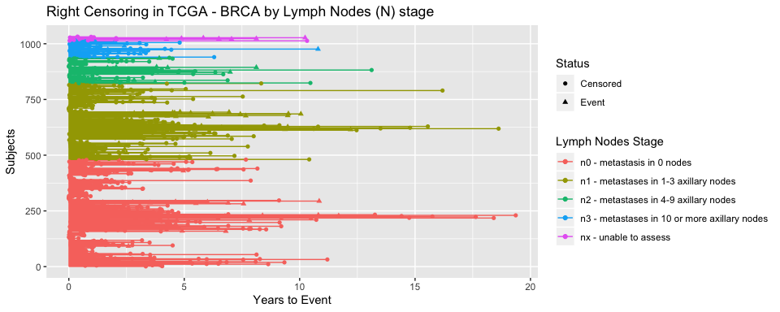
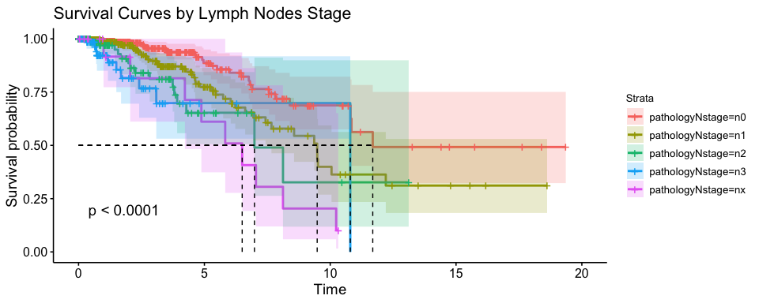
Lymph Nodes (N) Stage
Censoring & Event Plots
Kaplan Meier Survival Curve
Notes:
For 50% of the subjects, the cancer is in stage (no metastasis) and for 33% of the subjects the cancer has metasised to a few lymph nodes (stage n1). The survival rate decreases with the stage of the tumor from 95% for stage n0 to 55% in stage nX
The median survival time decreases from 11.7 to 6.5 from stage N0 to stage NX. All the survival curves are found to be significantly different.
Base model corresponds to group of subjects with no metastasis in the lymph nodes (stage n0).
For subjects in other stages, the risk of death
Increases by a factor of 1.95 when the metastasis increases to 1-3 lymph nodes (stage n1),
Increases by a factor of 3.15 when the metastasis increases to 4-9 lymph nodes (stage n2)
Increases by a factor of 5.22 when metastasis increases to 10 or more lymph nodes (stage n3). -The stage of the lymph nodes is a strong predictor of survival time.

Slide 35
Summary from Analysis of Individual Predictors
Important Predictors
Age
Treatment Type
Pathological Cancer Stage
Lymph Nodes (N) Stage
Notes:
Pathological Cancer stage is determined by the T,M, and N stages and so there is a strong correlation between Pathological Cancer Stage and Lymph Nodes stage.
In the multiple Cox Proportional Hazard model, we initially build two different models:
one with age at first diagnosis. Treatment type, and the pathological cancer stage
The other model is with and one with age at first diagnosis. Treatment type, and the lymph node staging. The model with pathological cancer stage is found to be a better fit and is considered here. Comparisons made using the AICc parameter (Akaike’s Information Criterion)

Slide 36
Multiple Cox Regression
Variables | Coef | HazardRatio | pvalue
age | 0.0233 | 1.024 | 2.24e-03
therapy_typehormone therapy | -0.4861 | 0.615 | 2.91e-01
therapy_typeNo Info | 1.1789 | 3.251 | 3.45e-05
therapy_typeOther | 0.2240 | 1.251 | 8.28e-01
pathologic_stagestage2 | 0.4533 | 1.574 | 1.54e-01
pathologic_stagestage3 | 1.0935 | 2.985 | 1.12e-03
pathologic_stagestage4 | 1.6852 | 5.393 | 1.10e-04
pathologic_stagestageX | 0.9725 | 2.645 | 3.91e-02
Notes:
In the absence of interactions, only four of the predictors are found to be significant.
The base model is age of 0, chemotherapy treatment and pathological cancer stage of 1.
The hazard ratio helps us to compare each predictor in a group with its base value.
For every increase in age at diagnosis by one year, the risk of death increases by a factor of 1.02
Compared to subjects on chemotherapy treatment, the risk of death increases by a factor of 3 for subjects on no treatment.
Compared to subjects diagnosed with stage 1 cancer, the risk of death increases by almost a factor of 5 with the increase in cancer staging diagnosis.

Slide 37
Multiple Cox Regression - Interpretation of Model
The Cox model equation can then be written as:
$$H(t)=H_{0}(t) exp(0.023*age+1.18*No_info+1.09*stage3+1.685*stage4+0.97*stageX)$$

Slide 38
Results
In the absence of any predictors, the median survival time for BRCA is 9.5 years
Important factors affecting survival time of BRCA
Age at first diagnosis
No therapy
Cancer stage 3
Cancer stage 4
Cancer stage X
Any metastasis into the lymph nodes
Notes:
What is median survival time?
What are the important factors? 3.. What are the effects of each factor on survival of breast cancer?
For every increase in age at diagnosis by one year, the risk increases by a factor of 1.02
Compared to patients on some type of treatment, the risk of death significantly increases by almost 5 times for patients on no treatment plan .
The risk of death increases steadily with increase in the diagnosed cancer stage number.
The number of lymph nodes that the tumor cells have metastasized to is a very significant factor with the risk of death increasing correspondingly.
How do all factors together influence the survival time of breast cancer?
Individually or together the results are similar.

Slide 39
R Functions for Survival Analysis
Purpose | Package::Function | Package::Graphical Wrapper
Extract Survival Data from TCGA | rtcga::survivalTCGA
Create Survival Object | survival::Surv()
Fit a Kaplan Meier Curve | survival::survfit | survminer::ggsurvplot()
Compare Kaplan Meier Curves using logrank | survival::survdiff() | survminer::ggsurvplot()
Fit a parametric model | survival::survreg
Fit Cox Proportional Hazards Model | survival::coxph() | survminer::ggforest()
Test for Proportional Hazards | survival::cox.zph() | survminer::ggcoxzph()

Slide 40
Outline
Reproducible Research
Concepts
Literate Programming
R Markdown
Case Study: Survival Analysis
Generating Different Types of Documents using R Markdown

Slide 41
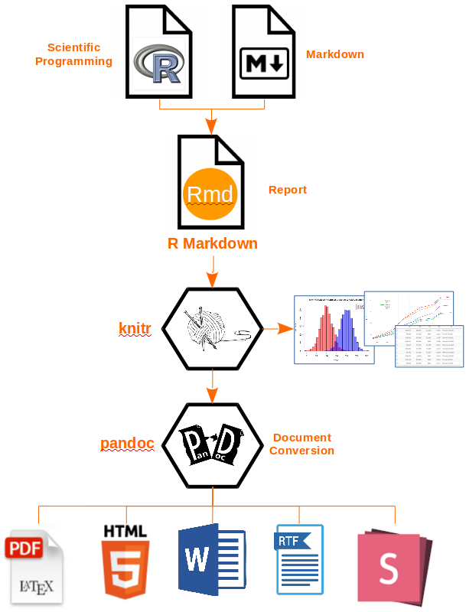
R Markdown Technology Stack
Three Frameworks
Markdown
for formatted text
Knitr
for embedded R code
YAML header
for rendering
Technology Stack

Slide 42
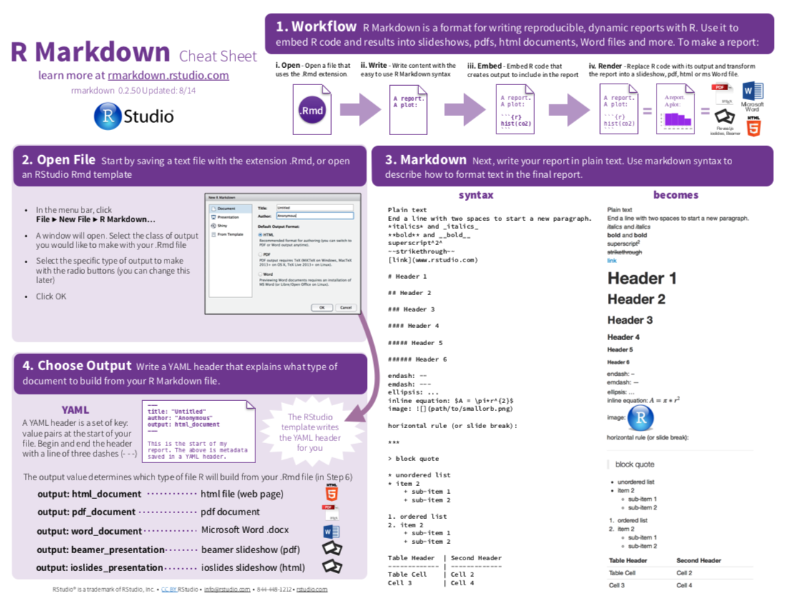
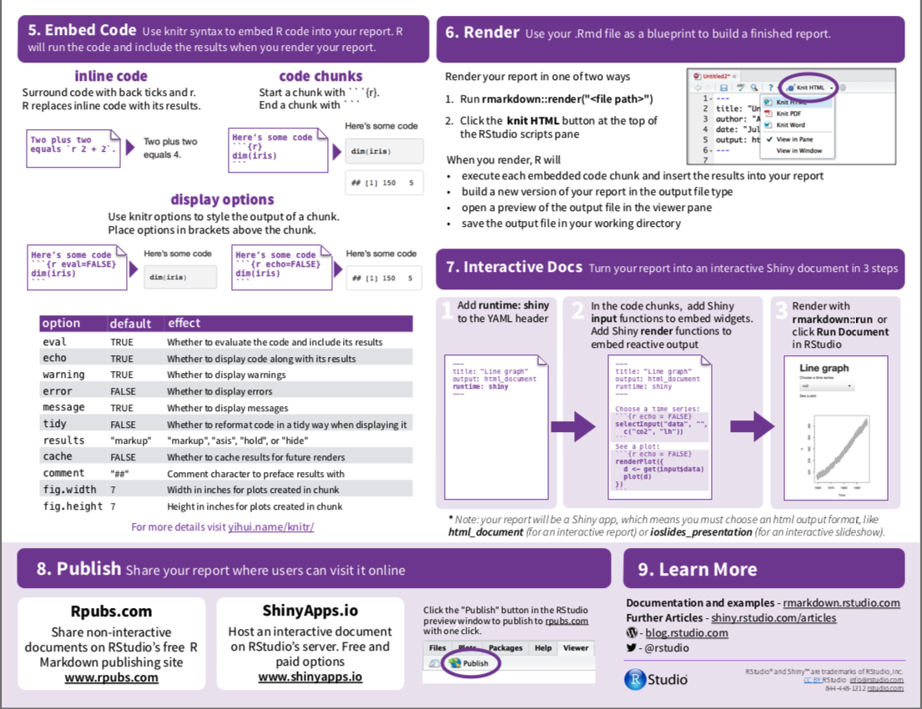
R Markdown

Slide 43
Markdown Basics
Character Styling *Italics*: Italics **Bold** : Bold `Inline Computer Code` Section Headers # Header 1 ## Header 2 Paragraph Styling - next line: two spaces at end of line - paragraph: blank lines
Lists - Numbered lists - Bullet lists - Nested lists Hyperlinks - [here](herelink.com) - ![Nice Image](image.png) Citations Cite using[@clinicalTrials]```
Notes:
Create bibiolography using BibTeX, BibLaTeX, EndNoteXML, etc
Add bibliography: ref.bib key value in YAML``

Slide 44
KnitR
{r clinical, echo=FALSE} # Extract the clinical data for difference cancers clin <- survivalTCGA(BRCA.clinical, OV.clinical, GBM.clinical, extract.cols=c("admin.disease_code","patient.drugs.drug.therapy_types.therapy_type"))
Global Options
{r setup, include=FALSE} knitr::opts_chunk$set( echo = FALSE, cache=TRUE)
Local Options
{r BRCA_extract, echo=TRUE, message=FALSE} plot(pressure)

Slide 45
YAML - Yet Ain’t Markup Language
--- title: "Untitled" author: "Ramaa Nathan" date: "Sep 19, 2019" output: html_document toc: yes pdf_document: toc: yes ---
Serialization standard for programming languages
First section in a Rmd document
Key: Value pairs surrounded by --- marks
Notes:
Key value pairs separated by colon
Nested key value pairs are indented

Slide 46
Rmd -> Other Documents
Document
HTML, PDF, Markdown, Word Document, Notebook, OpenDocument Text Document, Rich Text Format Notebook
Presentations
IOSlides, Slidy, Beamer, Powerpoint

Slide 47
Rmd -> HTML
--- output: html_document: df_print: kable messages: no number_sections: yes toc: yes toc_depth: 4 toc_float: yes ---
Most versatile
Kable and KableExtra packages for creating tables
Table of contents, figures, tables, equations work perfectly
Collapsible table of contents

Slide 48
Rmd -> PDF
--- output: pdf_document: df_print: kable number_sections: yes toc: yes toc_depth: 4 ---
Uses LaTeX
Table of Contents, Equations, and Figures are displayed correctly
Kable and KableExtra packages for creating tables
Need to specify kable(“latex”,booktabs=T)

Slide 49
Rmd -> Github Markdown
--- output: github_document: df_print: kable toc: true toc_depth: 4 ---
Tables, figures, and citations displayed correctly
Table of contents missing
Equations not interpreted correctly

Slide 50
Rmd -> Word Document
--- output: word_document: toc: yes toc_depth: 4 ---
Equations, figures, and citations displayed correctly
Tables do not print correctly
No numbered sections

Slide 51
Rmd -> Powerpoint
--- output: powerpoint_presentation: fig_width: 8 reference_doc: reference_wood.pptx ---
Requires Microsoft powerpoint to be installed in the local system
Requires RStudio Version 1.2.x with Pandoc version 2.x
Uses default powerpoint template to directly create .pptx file
Can use custom powerpoint template
Very easy to create slides
Notes:
Great features - Two column format, speaker notes,
No animations yet!!
The highest header level creates a new slide
Some adjustments may need to be made to the final version of the .pptx file
For examplefigures and tables always print on a new slide. Cannot combine speaker notes with them.

Slide 52
Last Steps of Reproducible Research
Public Repository (Github): SurvivalAnalysis
Create a repository on Github and upload the datafiles and the source code
Write a README.md
Create a project page for the applications and set up as a webpage
Container (Docker): ramabin/meetup_genpptx:rn_rladies
Create a Dockerfile and include all dependencies
Create the docker image
Push the docker image on the Docker repository
Notes:
HAVE YOU SHOWN THE DOCUMENTS? I am using only Github and Docker as examples. Any other relevant software can be used for this purpose.

Slide 53

THE END

